Slide 1
Diabetes, Obesity and Cardiometabolic health:
New Paradigms and Opportunities
Anthony Pick, MD, CDE
Endocrinology
NM Lake Forest Hospital
apick@nm.org
Disclosures: Speakers Bureau: Novo, BI/Lilly, Janssen, Astra Zeneca
Conflict of Interest: None

Slide 2
Perioperative Glucose Management
Lake Forest Hospital Fall 2017-
OBJECTIVES
Review links between diabetes, obesity, and cardiovascular disease
Discuss CV safety of diabetes medications & review landmark clinical outcome trials
Discuss diabetes and heart failure: SGL2 inhibitors, diabetic cardiomyopathies
Discuss lifestyle change approaches and multifactorial risk reduction
Discuss team/systems approach:
Cardiology, Endocrinology, Fitness, Nutrition/DM education, Bariatric Medicine, IT, Mental health

Slide 3
Perioperative Glucose Management
Lake Forest Hospital Fall 2017-
Endocrinology perspective of the heart
  Pump: distributes & responds to hormones & metabolites (glucose, free fatty acids, ketones, lipids, beta-agonists)
  Cardiovascular system is under neuro-endocrine, paracrine, autocrine and metabolic control
  Site of ectopic fat (analogous to NAFLD, pancreas, muscle, visceral fat stores)
  An endocrine organ: atrial myoctyes produce ANF, BNP (volume and BP regulation), other polypeptide hormones
Endocrinology: Focus on multifactorial CV risk reduction-primordial, primary and secondary
Diabetes, obesity, dyslipidemia, NAFLD, OSA, HTN: slow, often silent premature killing and maiming (esp. CV events)
Respect for Cardiologists for the acuity, importance and complexity of Cardiology care

Slide 4
Background
  Cardiovascular disease: Most common cause of morbidity, mortality in type 1 and type 2 diabetes
  Type 2 diabetes patients have worse outcomes with coronary artery disease and CHF
  Diabetic autonomic neuropathy, hypoglycemia associated with dysthymias, sudden death, adverse CV effects
  Insulin resistance and diabetes metabolic changes accelerate atherosclerosis
  Fatty liver and sleep apnea associated with adverse metabolic and cardiovascular outcomes
  CHF is common in type 2 diabetes, associated with high rates of morbidity and mortality
  Diabetic cardiomyopathy (not attributable to HTN, valve disease or CAD) may be common
  Cardiovascular calcification: complex, associated with prediabetes and diabetes

Slide 5
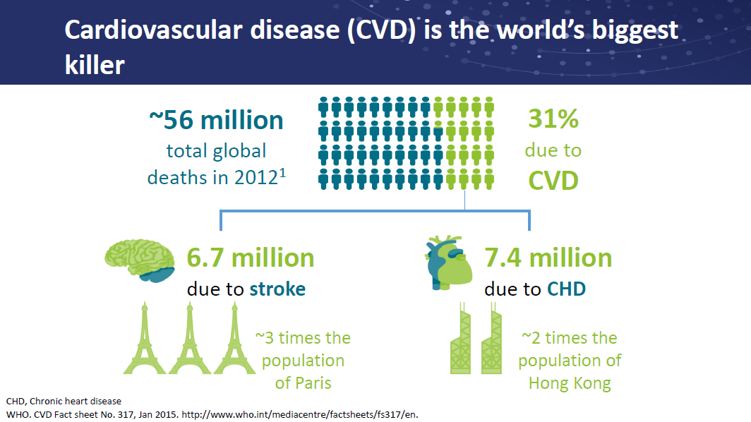

Slide 6
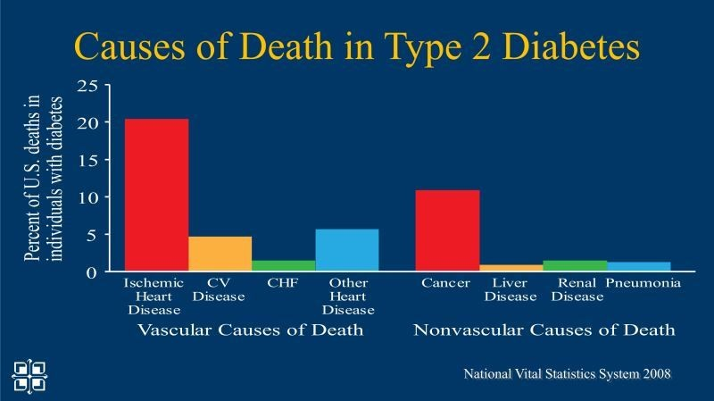



Slide 7
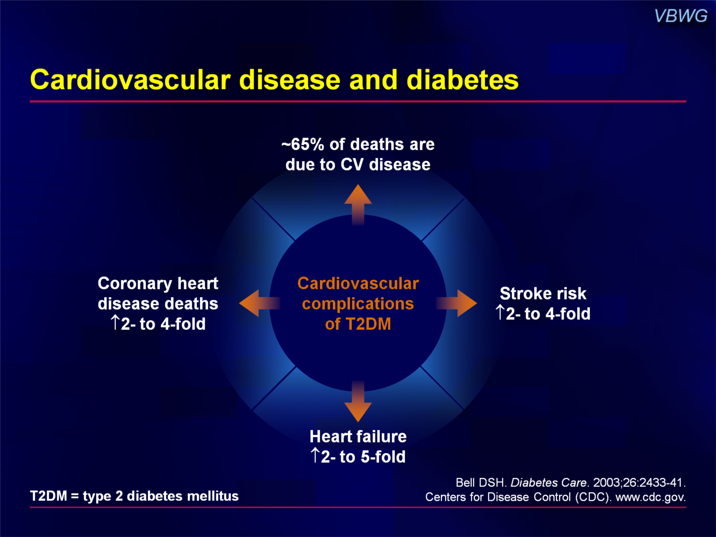

Slide 8
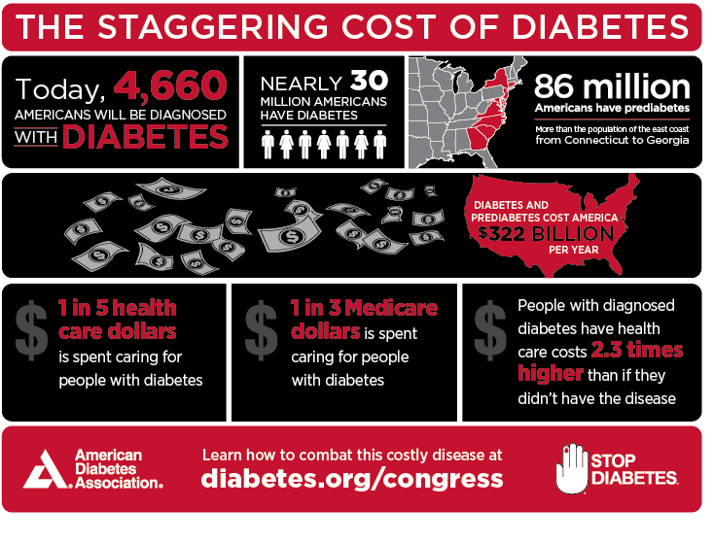

Slide 9
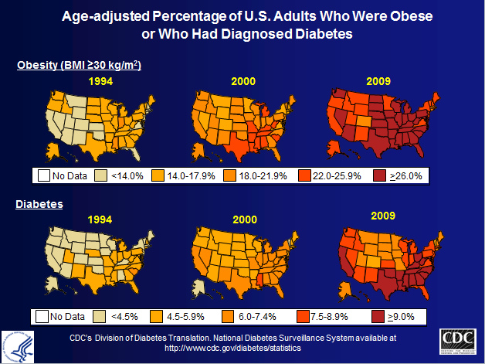
Type 2 Diabetes pathophysiology
Complex disorder(s) with multiple defects, genetic and environmental factors and multiple associated complications and comorbidities
Most patients with type 2 diabetes are overweight or obese (with associated insulin resistance and increased visceral fat (fuel overload, tissue spill-over))
Can think of root cause as fuel storage and metabolism disorder (increased visceral fat, insulin resistance, complex mechanisms), genetic, epigenetic plus environmental factors with superimposed beta-cell failure
There must be beta-cell dysfunction/hypofunction to result in hyperglycemia (compensatory hyperinsulinemia before prediabetes and diabetes).
The beta-cell deterioration is usually progressive (but can be reversed or prevented)
Other types of diabetes may be present (LADA, DM1 with obesity/insulin resistance, MODY/mono-genetic, other secondary causes)

Slide 10
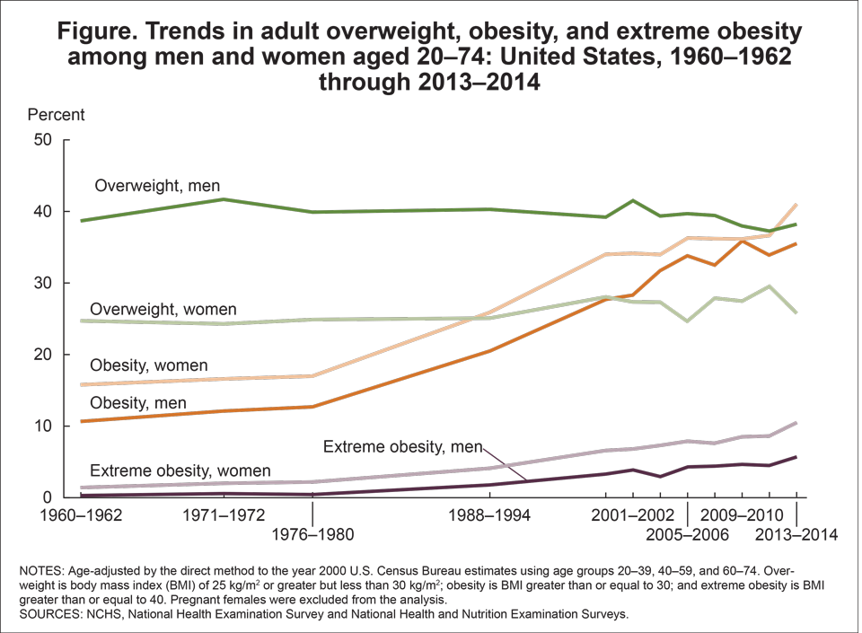

Slide 11
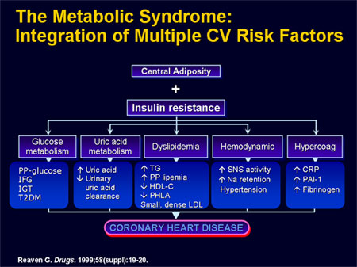
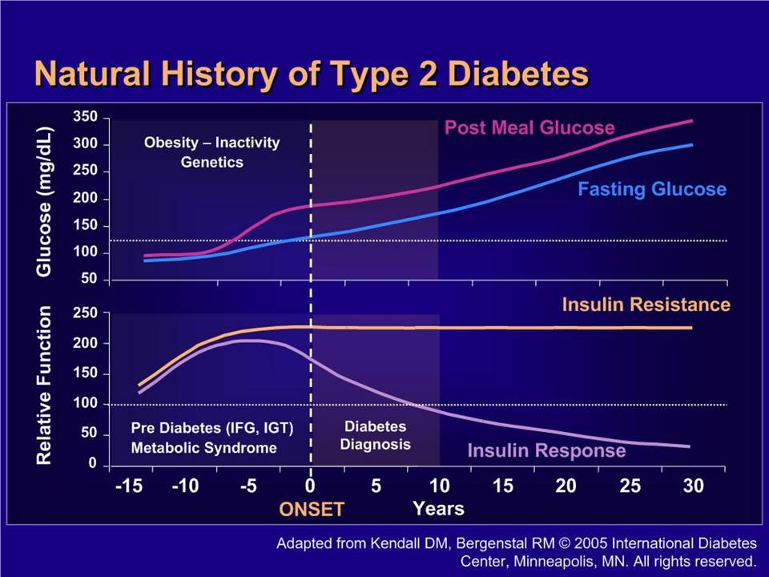

Slide 12
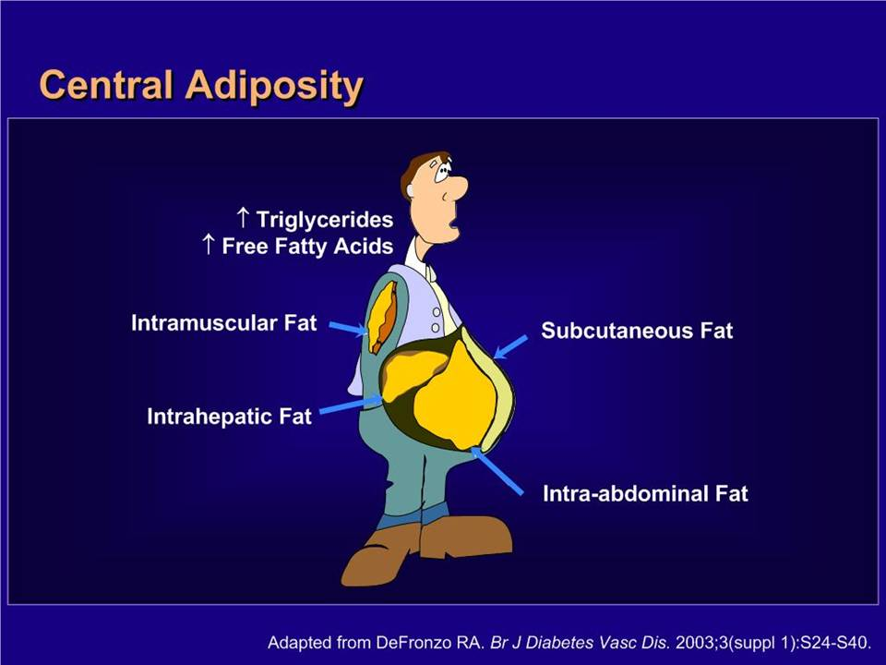

Slide 13
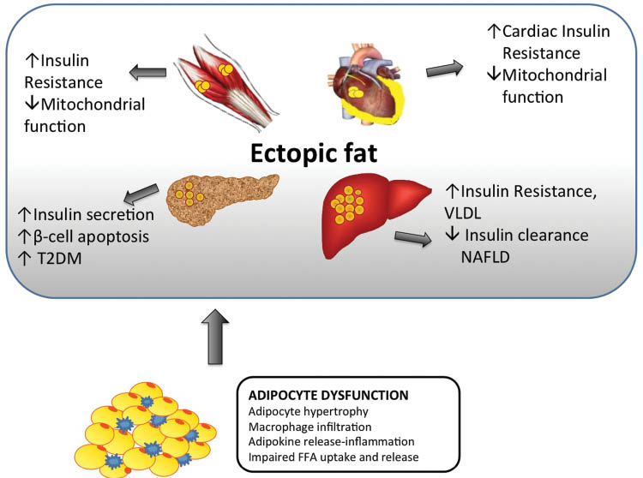

Slide 14
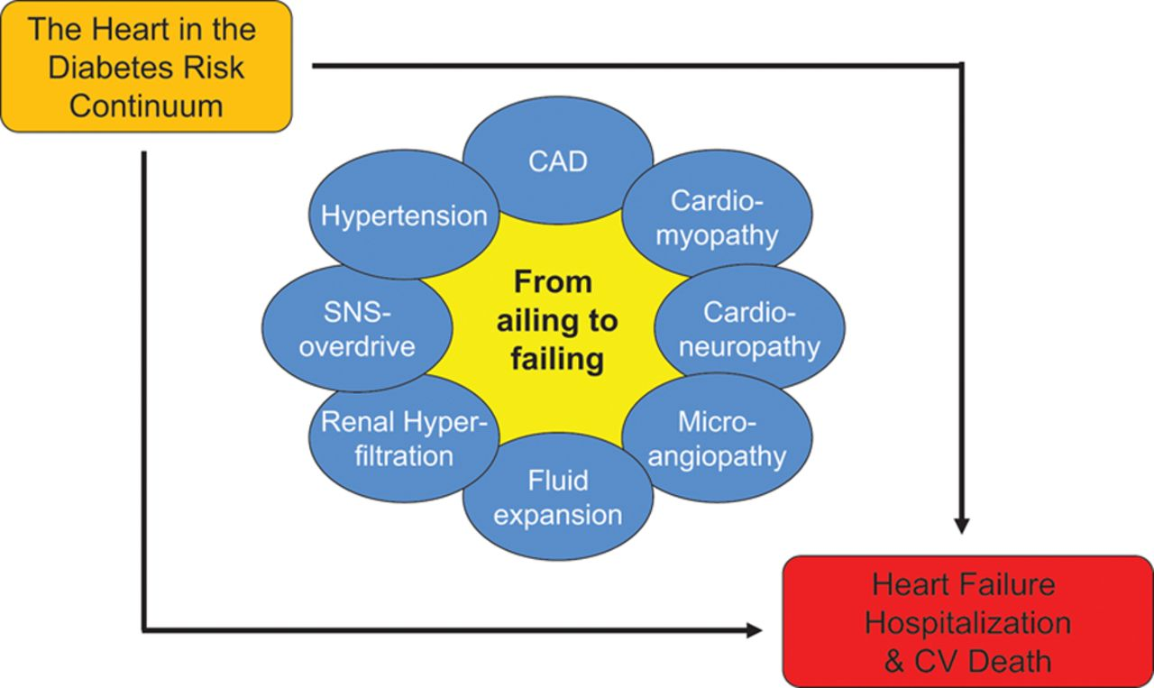

Slide 15
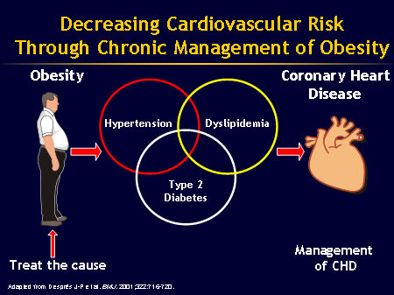

Slide 16
Perioperative Glucose Management
Lake Forest Hospital Fall 2017-
Obesity and CV health
Obesity is a complex, common, chronic and relapsing disease
Multiple comorbidities:
NAFLD, dyslipidemia, metabolic syndrome, OSA, HTN, Afib, diabetes, CHF, CAD, CVA, cancers
Stigma common: shaming and blaming
Lack of understand of pathophysiology is common:
Neuro-endocrine disorder NOT willpower failure: genetic factors + obesogenic environment
Advise to “eat less and exercise more” is operationally useless
Akin to “buy low sell high to get rich”, “cheer up, if suicidal”, “just say no to drugs”

Slide 17
Obesity and CV health
Hunger can be from fuel need; stress/boredom/comfort; hedonistic eating
Processed foods: Sugar, fats, salty foodstuffs addictive
Reward center activity analogous to heroin, cocaine, nicotine, smart phones
Hypertension, diabetes and lipid disorders are treated with medications, why not obesity?
Weight loss associated with counter-regulation responses:
Thermic adaptation, increased muscle efficiency, higher ghrelin, lower GLP1, NPY, others

Slide 18
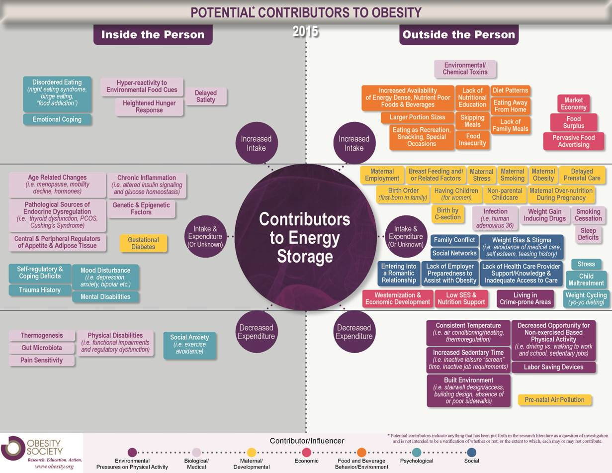

Slide 19
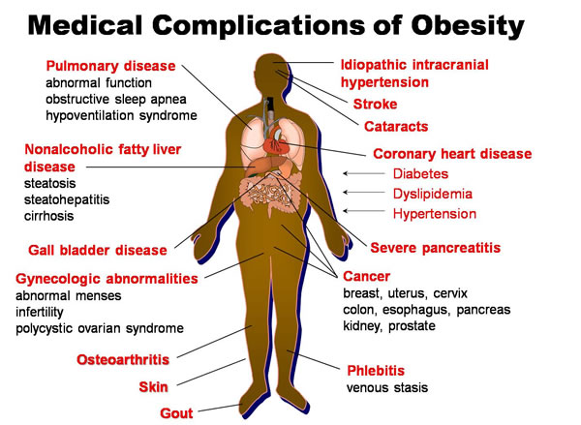

Slide 20
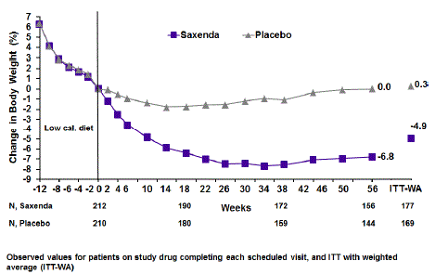
GLP1-analog liraglutide 3mg daily: Weight loss drug
Lifestyle: 6% weight loss—500 calories, + 150 minutes exercise
GLP1 analog: extra 7% weight loss, 13% total
No change in activity or energy expenditure
GLP1 analog effect due to increased satiety (not nausea)
Weight loss sustained over 1 year
5-10% weight loss is clinically meaningful and realistic goal
Weight regain typical in trials and clinically (thermic, other adaptations)

Slide 21
Perioperative Glucose Management
Lake Forest Hospital Fall 2017-
Obesity Treatment
Lifestyle change: 5-10% average weight loss range (activity, nutrition, sleep, behavioral health)
Medication: 5-20% average weight loss range
Indications: BMI > 30, BMI > 27 with comorbidities eg DM2, HTN, OSA, NAFLD
Phentermine: short term use, generally safe, inexpensive (avoid with uncontrolled HTN, unstable cardiac Dz)
Phentermine-Fenfluramine banned (pulmonary HTN, valve disease), usually safe, cheap
Approved for long term use: Xenical, Phentermine-topiramate, locaserin, bupropion-naltrexone, liraglutide
Surgery: Indications: BMI > 40, > 35 with comorbidities
Often dramatic improvement in diabetes control
Weight loss > 20%
Avoid with unstable mental illness, active eating disorders
Metabolic effects: change in Gut biome, GI-brain signaling, appetite regulation, bile acid metabolism
STAY TUNED: comprehensive North Region Medical Weight Management program under construction

Slide 22
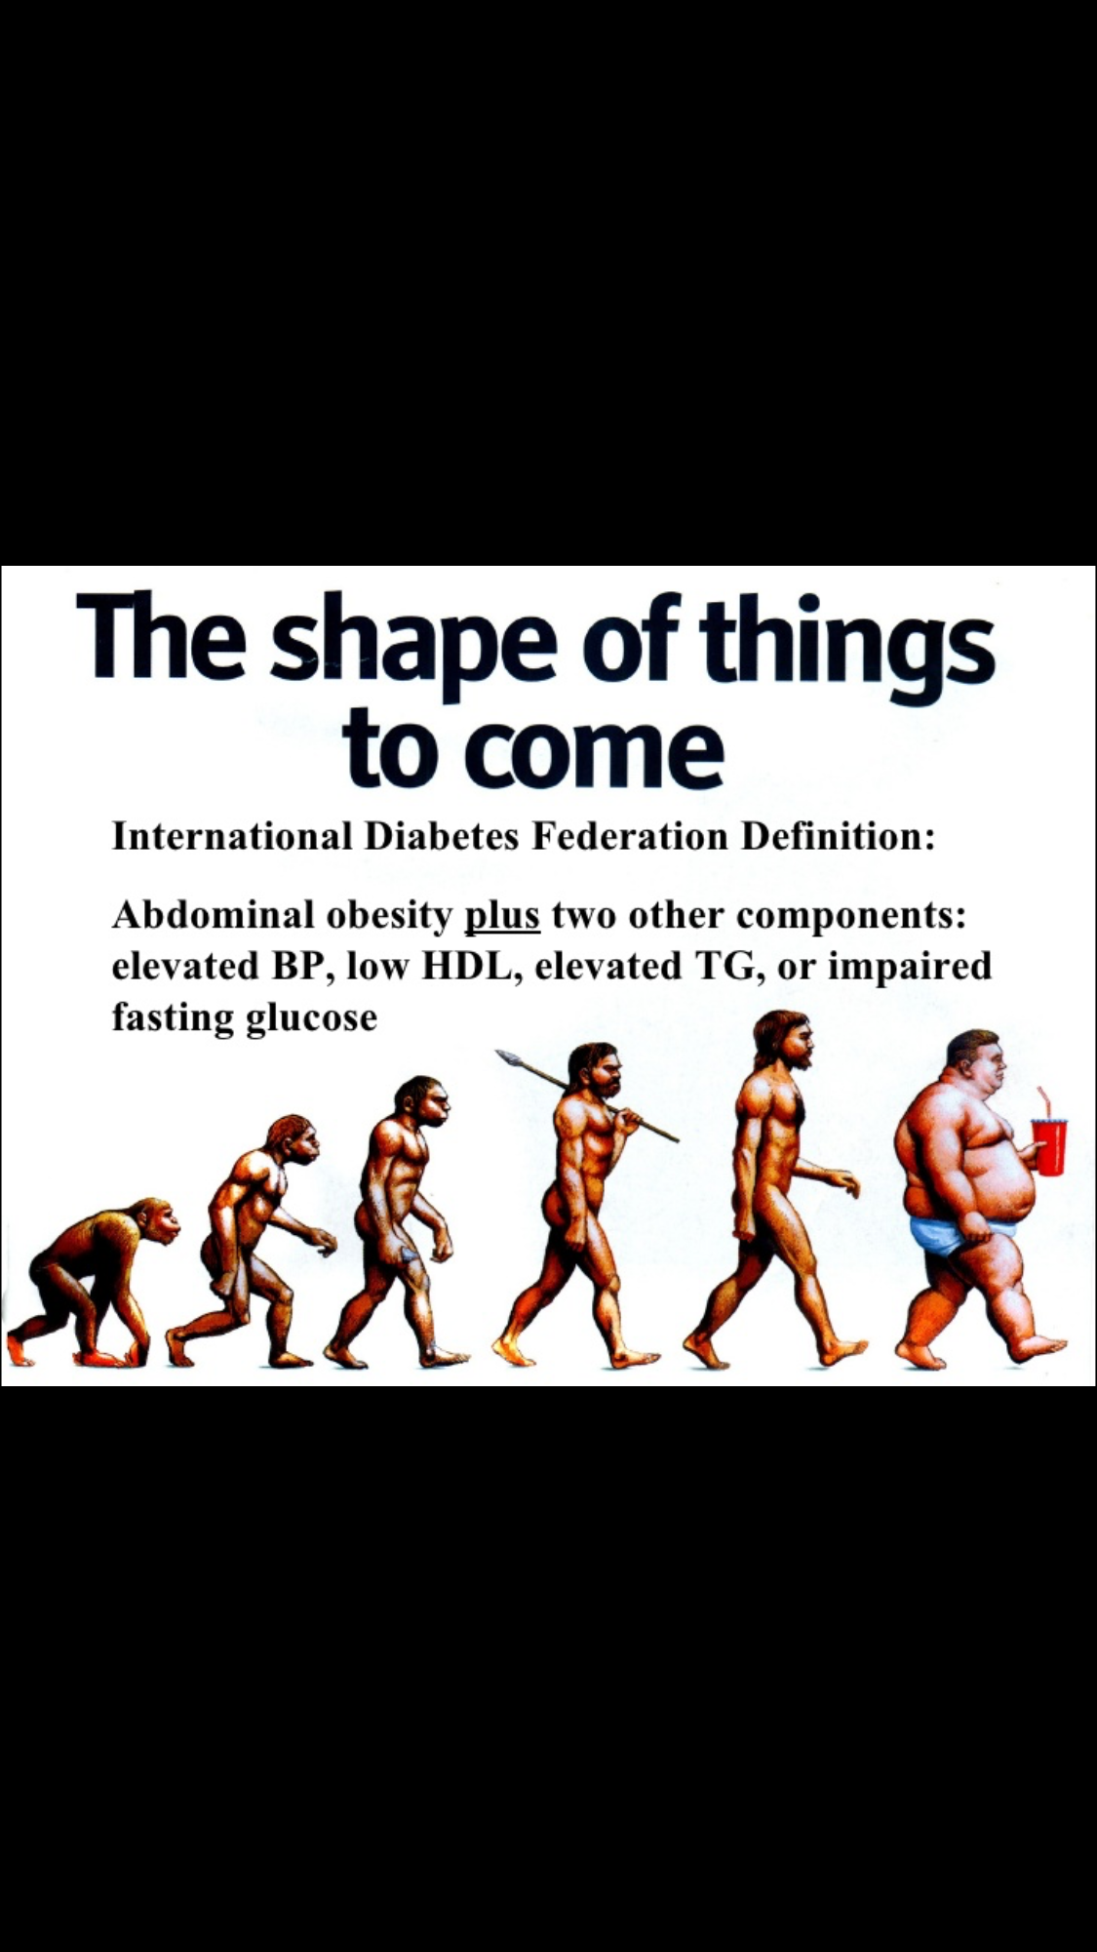
Type 2 Diabetes is a combination of genetic and environmental factors.
Evolutionary pressure with insecure food supply likely selected for insulin resistance genes (thrifty genotype).
Historically adapted to hunter-gatherer lifestyle
Metabolic defects associated with excess fuel loading (glucolipotoxicity), tissue spill over and other complex mechanisms
Obesogenic/diabetogenic environments and lifestyle (stress, prolonged sitting, sleep disturbance, body clock dysfunction, hedonistic food sources)

Slide 23


Slide 24
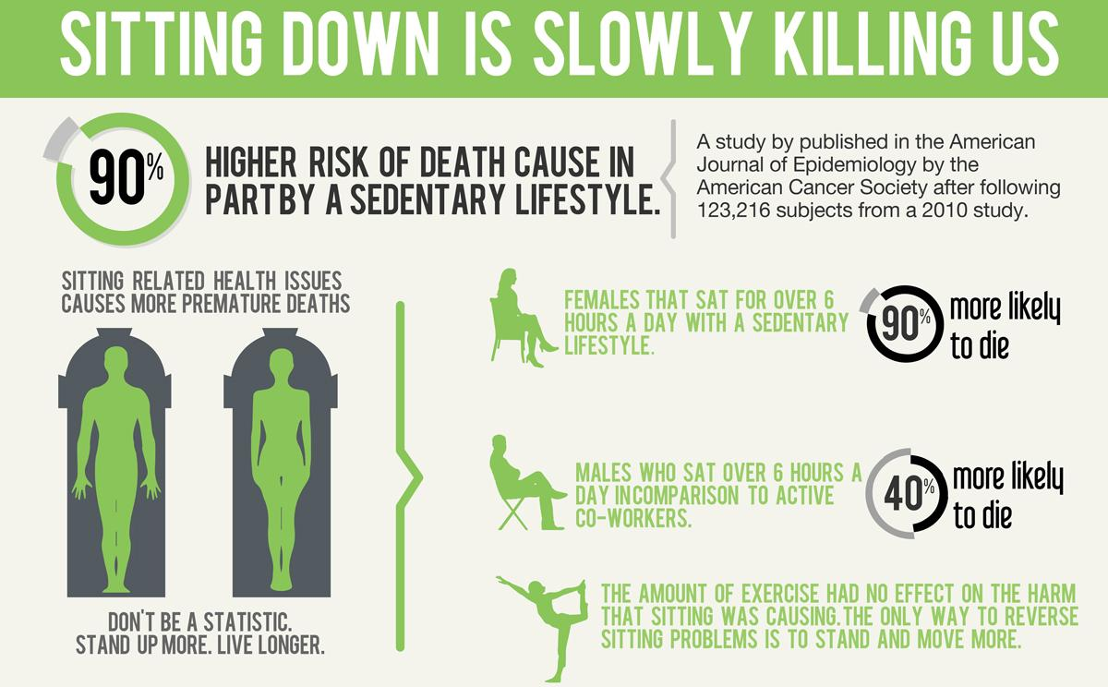

Slide 25


Slide 26
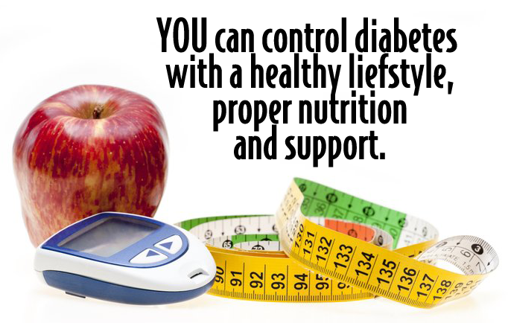
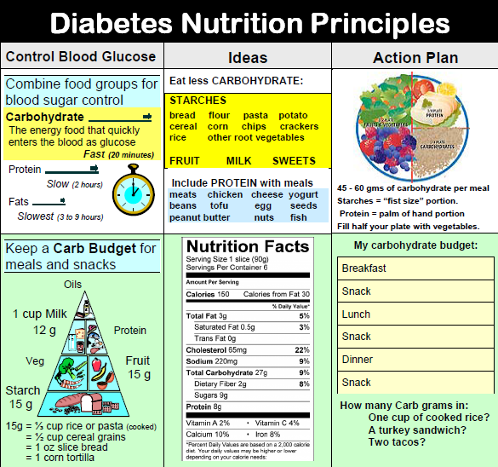
Diabetes, Obesity, HTN, dyslipidemia and Nutrition
Dietary approaches: Mediterranean, DASH, low carbohydrate/low glycemic index, “Portfolio”
Healthy whole food approach, low fat diet controversial (AHA)

Slide 27
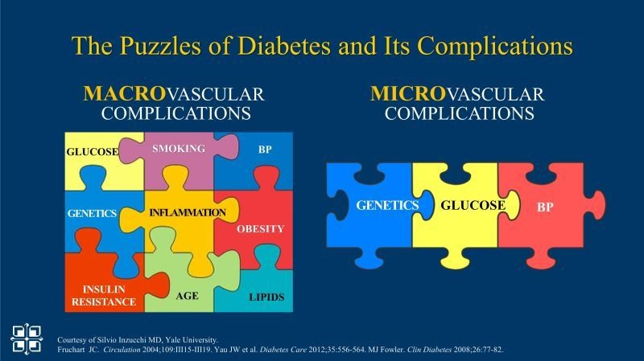

Slide 28
Comprehensive Risk Factor Management
Steno-2 Trial in Copenhagen, Denmark with 7.8 years of intensified, multifactorial intervention in DM2 and microalbuminuria (NEJM, 2008; 358: 580-91)
160 middle aged patients within 5 years of DM2 Dx with conventional therapy versus behavioral and pharmacological therapy
Lifestyle change, aspirin, smoking cessation, ACEI, Statin, BP and DM Rx algorithms
At 21 year follow up the intensive group survived a median of 7.9 years longer, with median time before 1st CV event was 8.1 years longer (Diabetologia (2016) 59:2298-2307) with less microvascular disease
Landmark trial highlighting benefit of early intervention and targeting
multiple risk factors, profound implications for health delivery systems

Slide 29
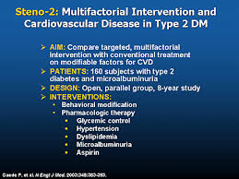
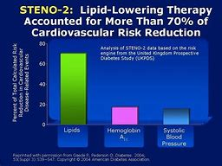
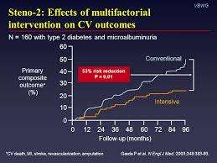
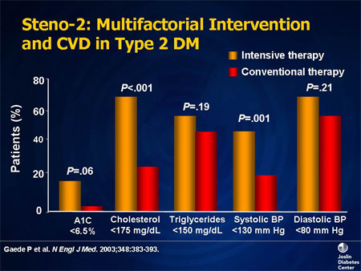

Slide 30
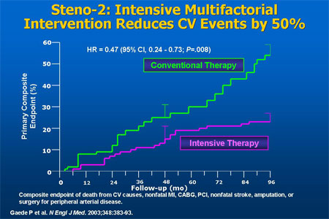

Slide 31
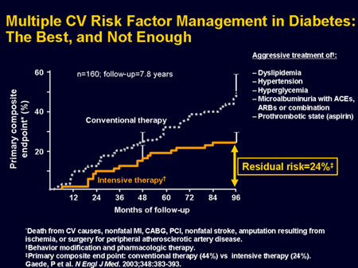

Slide 32
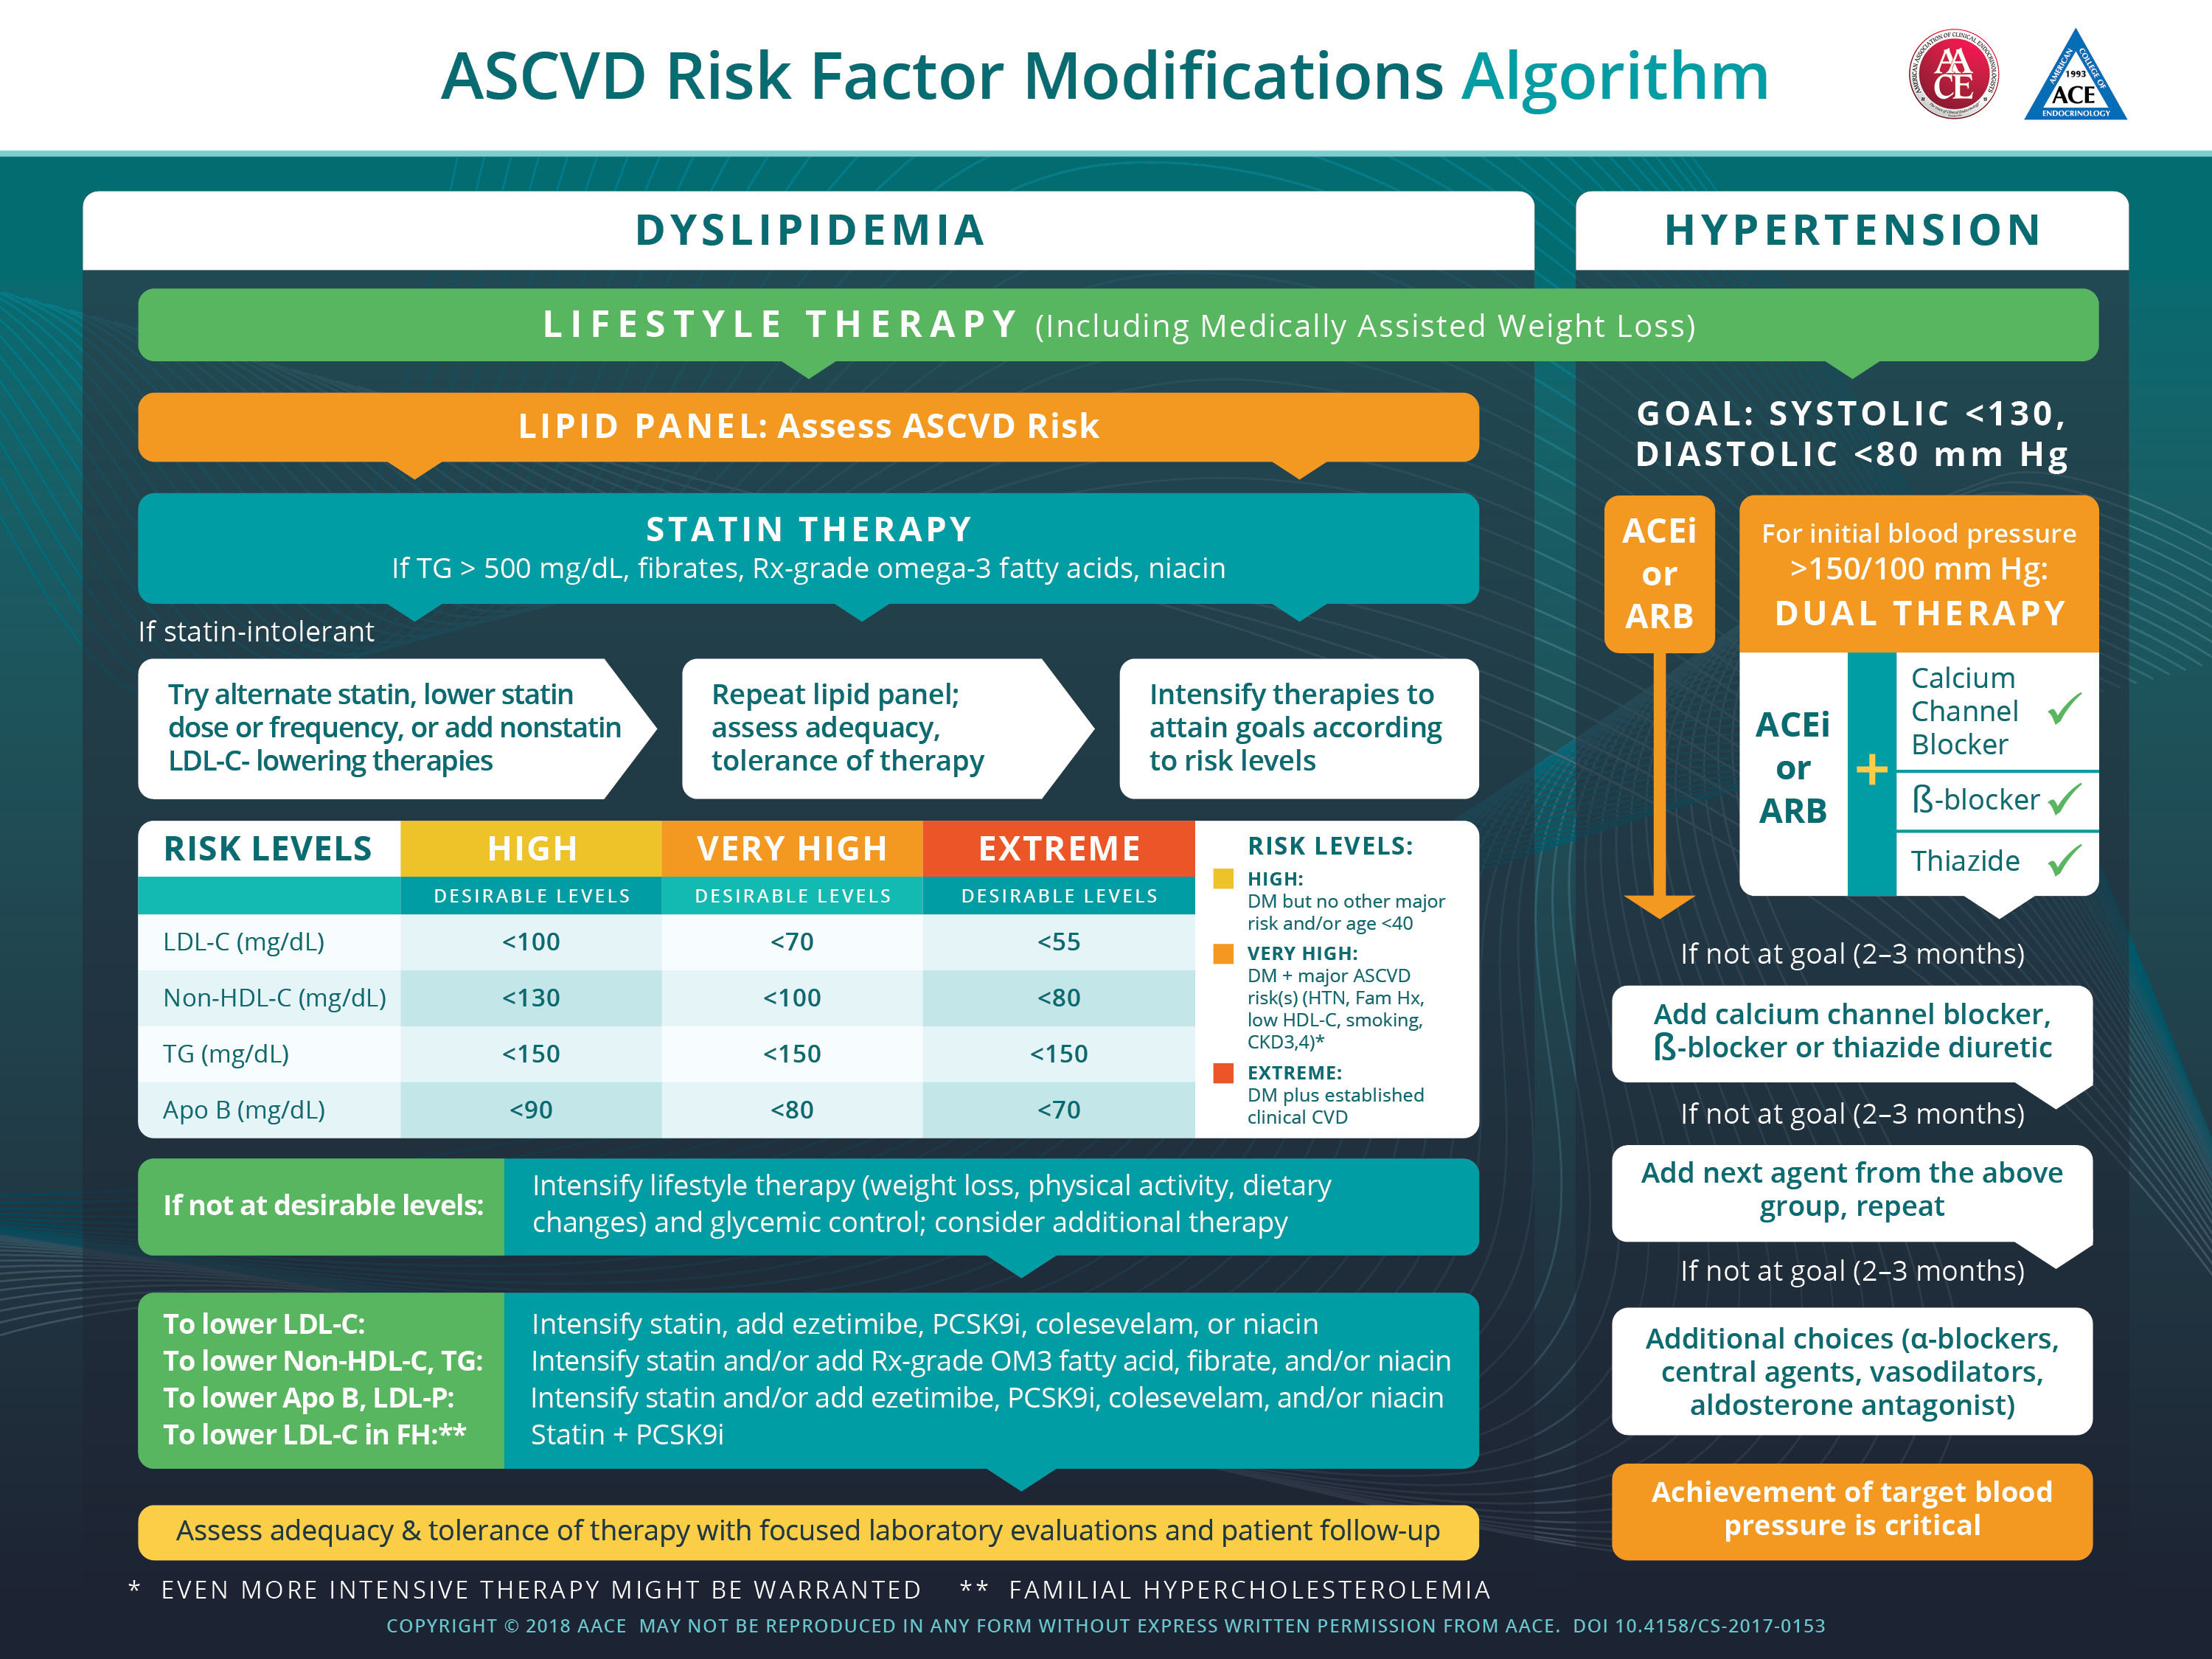

Slide 33
Perioperative Glucose Management
Lake Forest Hospital Fall 2017-
Diabetes Medications and CV risk
  Sulfonylureas: hypoglycemia risk, weight gain, may block ischemic preconditioning, no CV benefit versus possible harm
  Metformin: Considered safe from CV perspective, modest weight loss, low hypoglycemia risk
  TZDs (pioglitazone): Fluid retention/CHF risk, improve lipids, NAFLD, CV secondary outcomes, stroke prevention (IRIS)
  rosiglitazone (Avandia) had a CV safety signal and prompted new CVOT trials 2008-
  DDP4i: CV effects neutral, saxagliptin, linagliptin associated with CHF
  Insulin: Glargine: neutral CV effects, weight gain, hypoglycemia
  ACCORD, VADT trials (pre-GLP1, SGL2i) no CV benefit and potential harm with A1c <7%
  AGI Acarbose showed improved CV outcomes in impaired glucose tolerance; CV data with short acting bromocriptine

Slide 34
Perioperative Glucose Management
Lake Forest Hospital Fall 2017-
Landmark cardiometabolic trials
  LEADER trial: GLP1 analog liraglutide indicated for reduction of stroke, MI and CV death
  Sustain 6: Weekly GLP1 analog with CV safety, up to 16% weight loss: ?Dm2, obesity and CV drug
  Empa-Reg: SGL2i-empagliflozin indicated for reduction of CV death, less CHF and progression of CKD
  Canvas trial: positive CV outcomes with canaglizozin (0.6 % risk of Le amputations)
  CV real: Supports class effect of SGL2i for CV, renal and CHF effects, observational study
  Proactive and IRIS: Pioglitazone less stroke, MI CV death as secondary outcome, decreased CVA risk (50% range)
  Steno-2: DM2 multifactorial risk management improved micro and macrovascular outcomes
  Predimed: Mediterranean diet and CV outcomes

Slide 35
Are Sulfonylureas safe?
Accelerate beta-cell failure
Weight gain
Hypoglycemia: frequently seen with CGMS (~30%, often unrecognized), QT dynamicity and QTc prolongation seen on holter in some patients (Diabetes Care May 2017,V40, 663-670)
Glyburide blocks myocardial ischemic pre-conditioning (K-ATP channel effect)
Literature conflicting but question of CV harm versus neutral (1st generation vs 2nd-3rd)
Black Box warning still in place, UGDP 1970 (PLOS Med April 12th 2016)

Slide 36
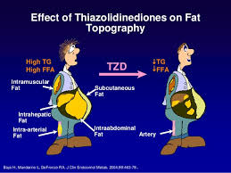
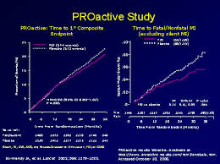
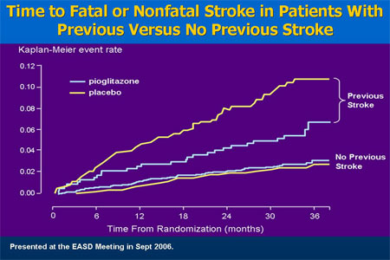
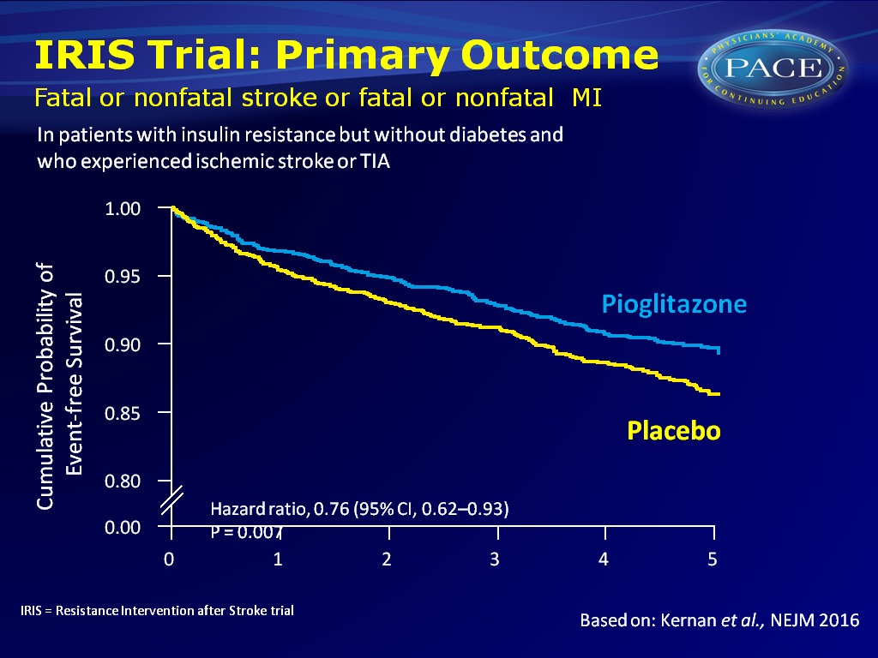
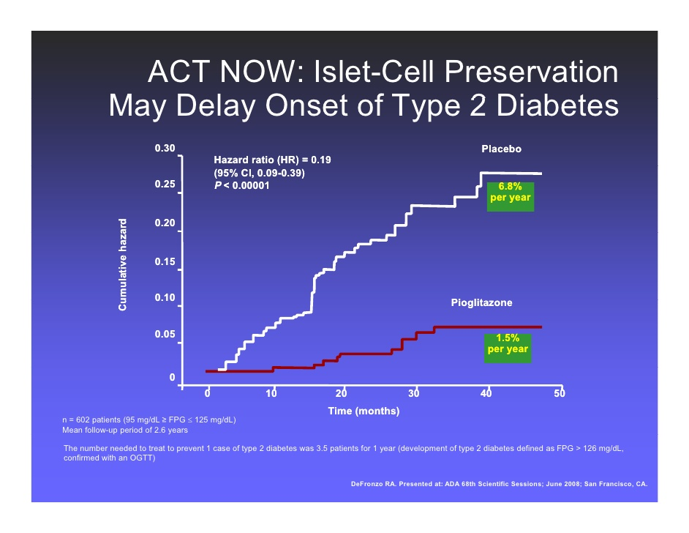
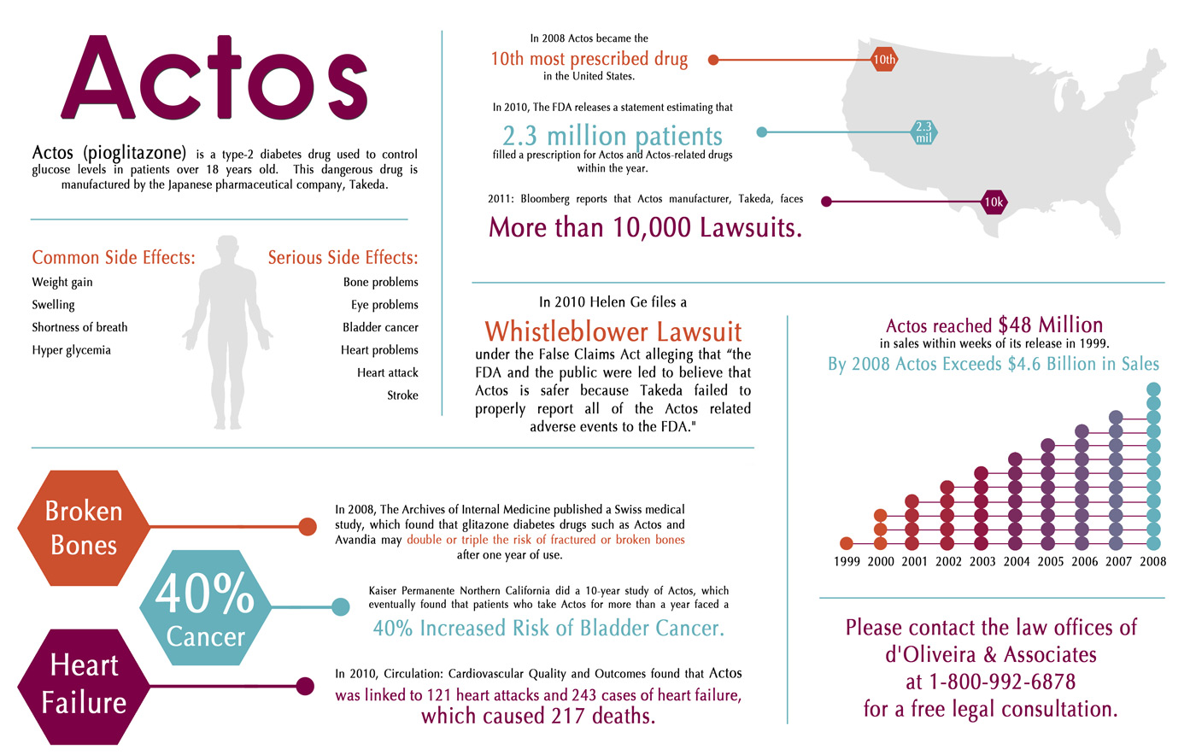
Pioglitazone risk vs. benefits

Slide 37
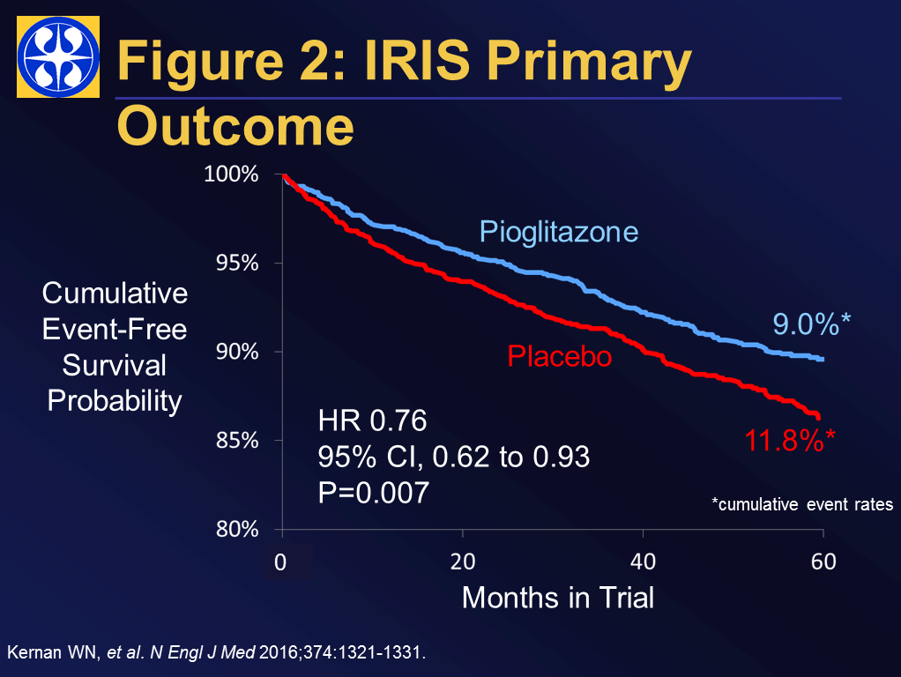

Slide 38
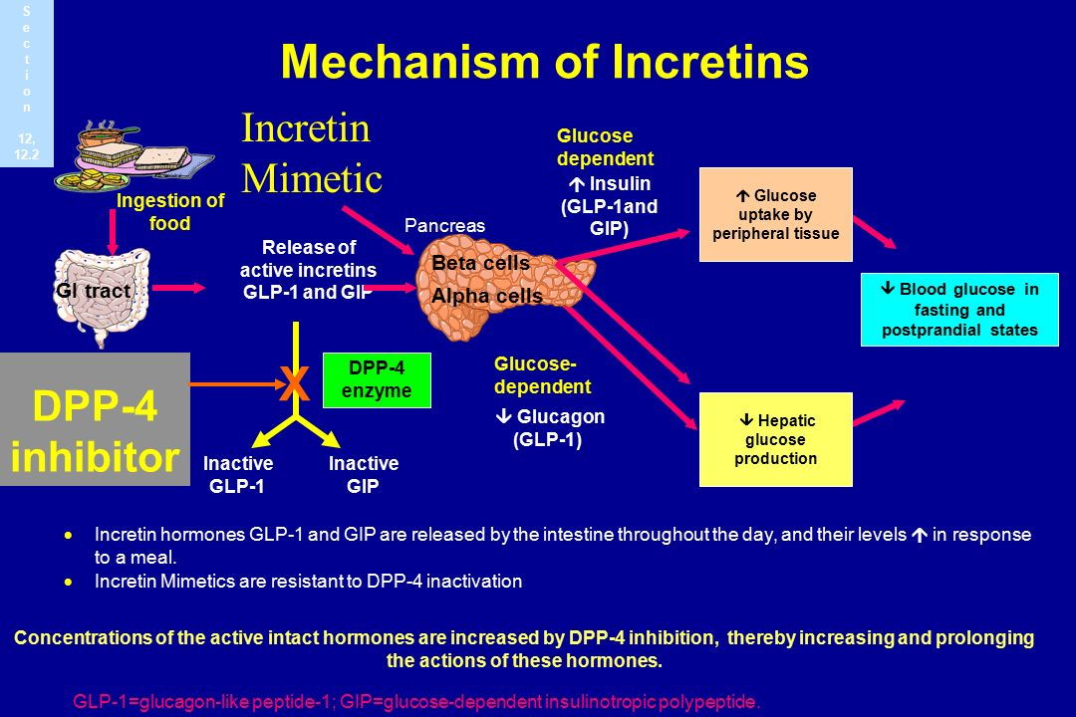

Slide 39
Perioperative Glucose Management
Lake Forest Hospital Fall 2017-
GLP1 analog Effects
  Increase insulin secretion, suppress glucagon, may slow gastric emptying and central appetite effect
  Restore beta-cell responsiveness, may protect beta-cell mass, promote weight loss, improve NAFLD
  Low risk of hypoglycemia, unless with insulin, sulfonylureas
  Most comprehensive physiological targets
  Commonest side effect GI, cases of pancreatitis, gallstone disease, “poor house” as expensive
  Positive CV outcomes ? Mechanism
  May increase resting heart rate, usually trivial (receptors in SA node)
  Positive renal effects

Slide 40
Perioperative Glucose Management
Lake Forest Hospital Fall 2017-
GLP1 analog use
  Indications: Type 2 diabetes (obesity-liraglutide 3mg daily)
  Contraindications: allergy, MEN2, medullary thyroid carcinoma
  Warning: Pancreatitis patients excluded, medullary thyroid carcinoma in rodents
  Humans have little to no GLP-1 receptors in the thyrocytes
  Pros: Low risk of hypoglycemia, effective glucose control, appetite suppression, +ve CV outcomes(? Class)
  Cons: Expensive, GI side effects, SQ injection, small risk of pancreatitis and gallstones
  Choices: Exanatide BID or weekly; liraglutide lixisenatide daily; dulaglutide, semaglutide weekly

Slide 41
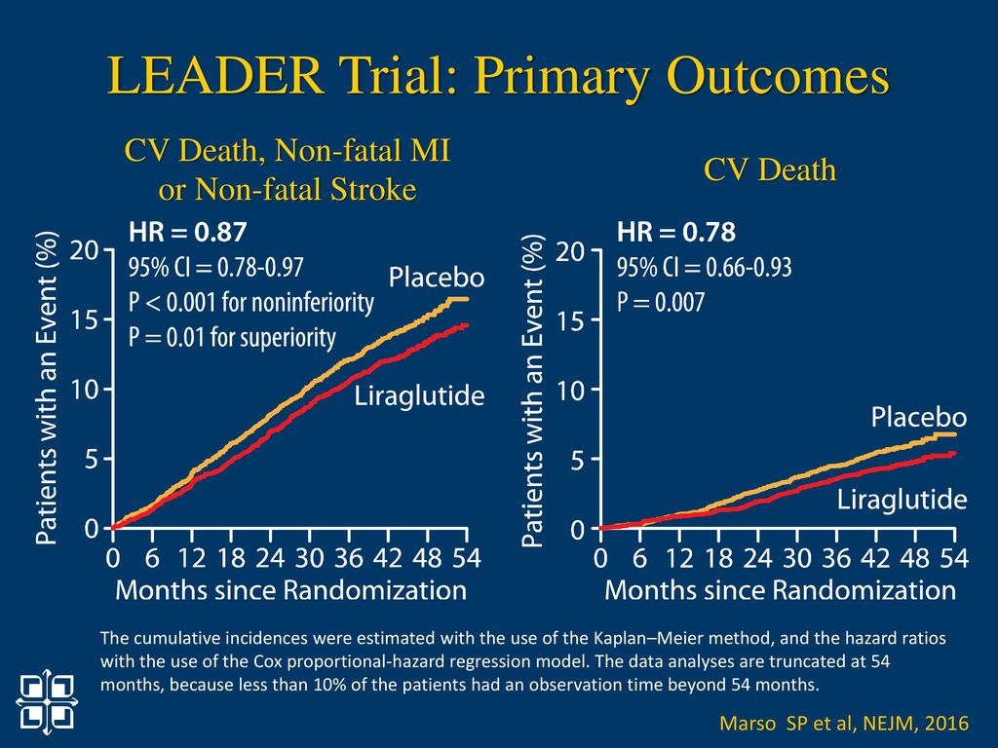

Slide 42
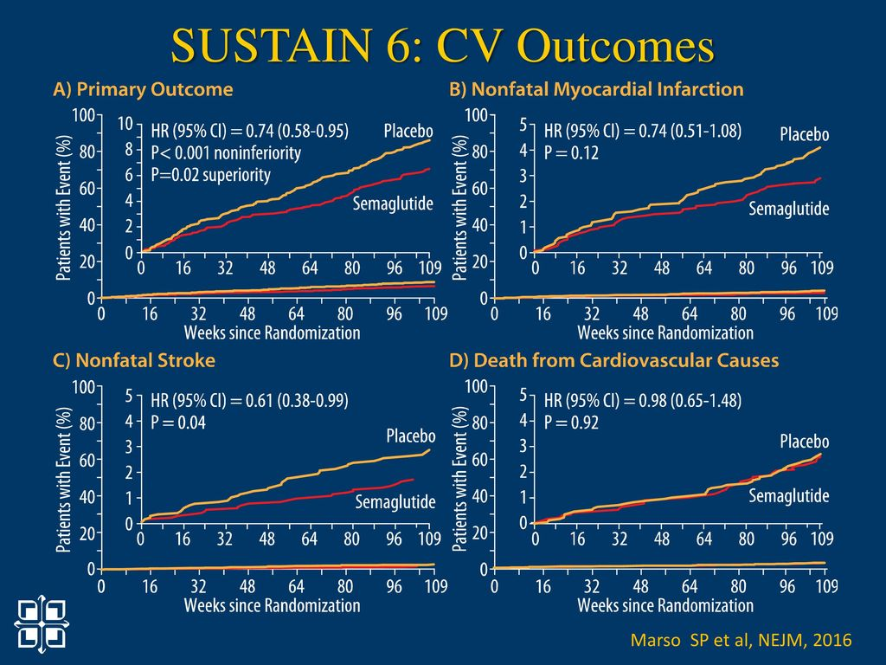

Slide 43
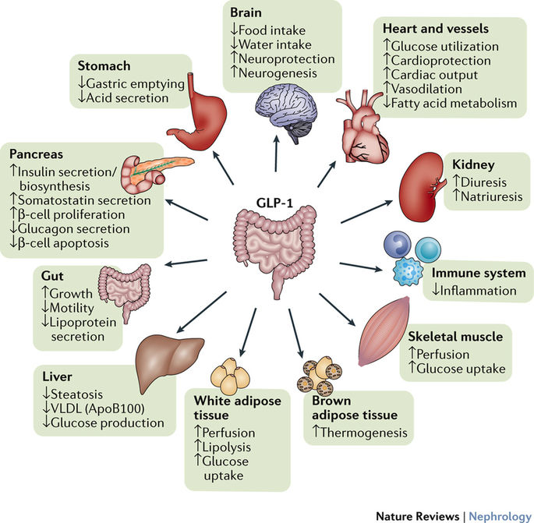

Slide 44
Perioperative Glucose Management
Lake Forest Hospital Fall 2017-
Sodium Glucose 2 Transport inhibitors
  Indications: Type 2 diabetes
  Contraindications: allergy, eGFR < 45
  Warning: Cases of DKA in Latent type 1, type 1 diabetes (not FDA approved)
  Pros: Low risk of hypoglycemia, effective glucose control, weight loss, +ve CV outcomes(? Class)
  Cons: yeast infections, bladder infections, urinary frequency, hypotension, dehydration, (amputations, fractures)
  Choices: canagliflozin (Invokana), dapagliflozin (Farxiga), Empagliflozin (Jardiance), ertugliflozin (Steglatro)

Slide 45
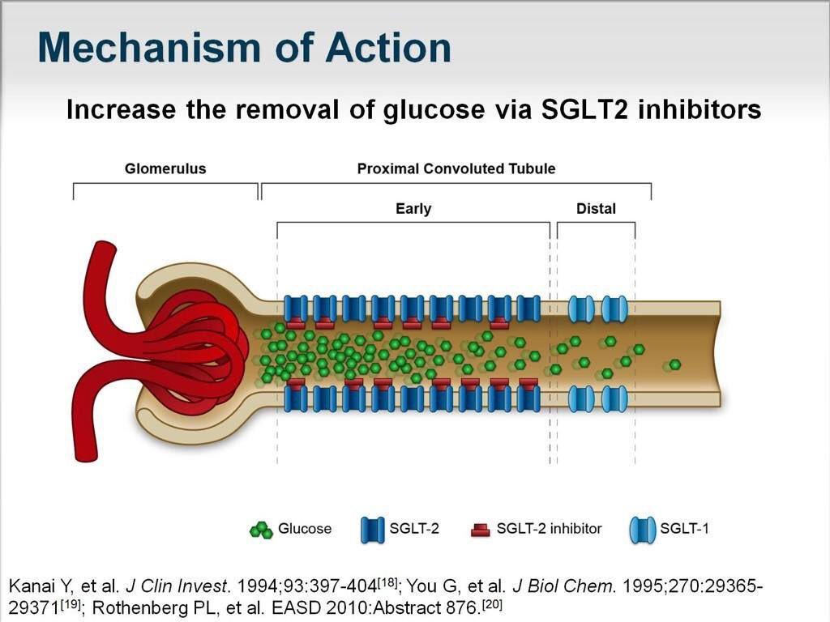

Slide 46
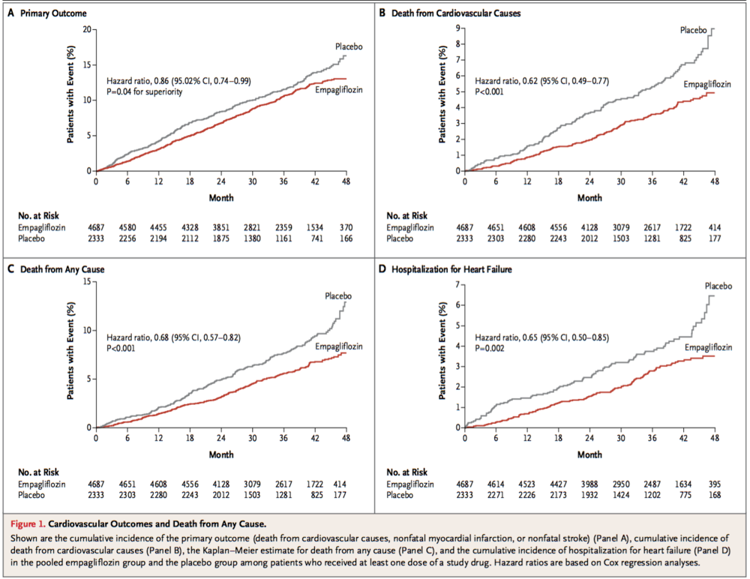

Slide 48
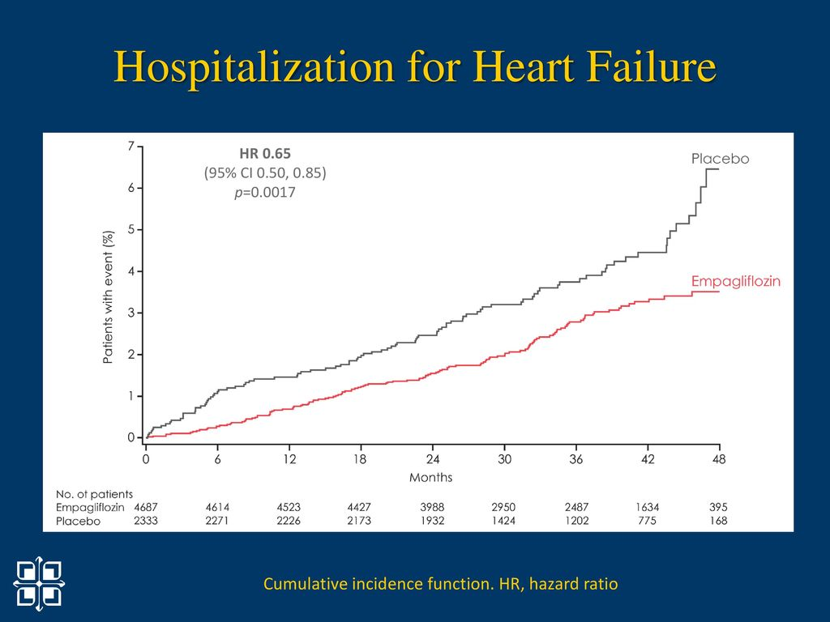

Slide 49
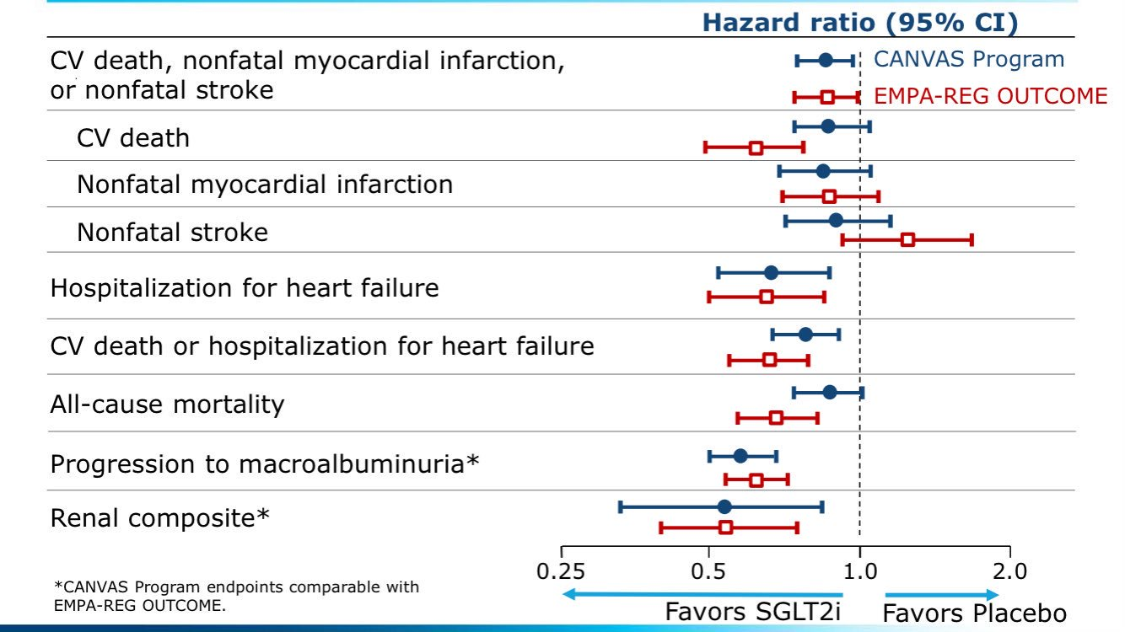

Slide 50
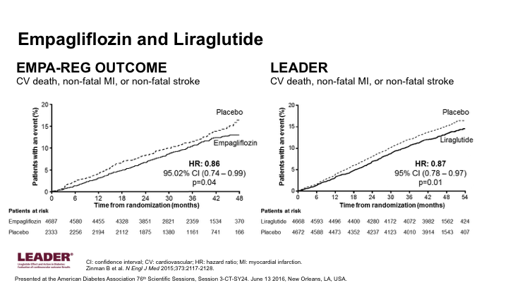

Slide 51
Perioperative Glucose Management
Lake Forest Hospital Fall 2017-
SGL2i Mechanisms of action
Glucose lowering, weight loss by urine glucose excretion 70-100 mg/dl/day = 300-400 calories
Volume contraction occurs
Decreased cardiovascular death independent of A1c levels, early effect
Effect not explained by weight loss, blood pressure reduction
Theories include hemodynamic effects, changes in fuel metabolism (ketones, FFA changes)

Slide 52
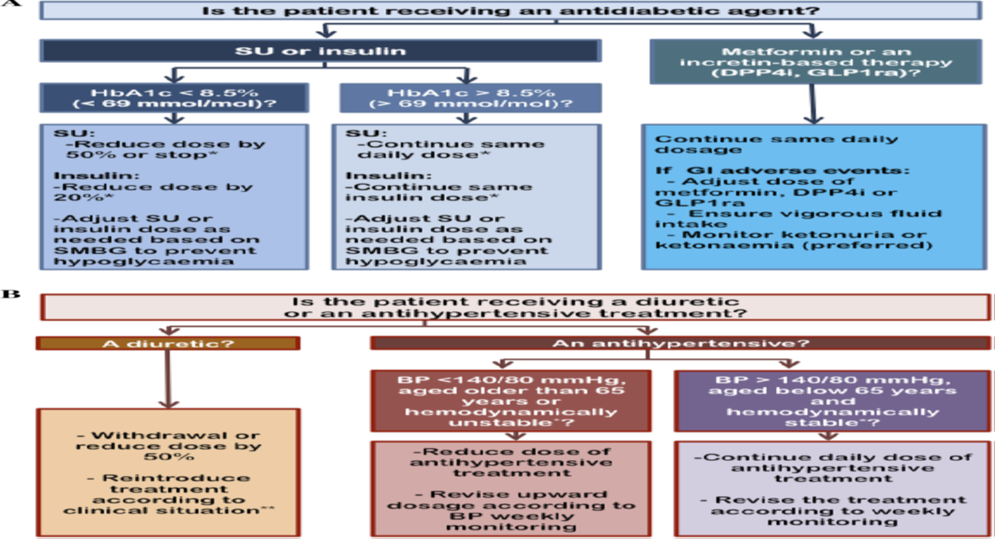
Perioperative Glucose Management
Lake Forest Hospital Fall 2017-
  XX
  SGL2i use in Cardiology:
  Consider DM2, CHF, CV risk
  eGFR > 45 (clinical trials > 30)
  Cut diuretic 50% or per clinical status
  CHF: Monitor BP, volume, renal function, K
  Avoid hypoglycemia
  Patient selection and monitoring NB!
  Umpierrez G, et al: Practical Approach to Initiating SGLT2 Inhibitors in Type 2 Diabetes. Diabetes Ther (2017) 8:953-962

Slide 54
Perioperative Glucose Management
Lake Forest Hospital Fall 2017-
DIABETES and CHF
Common, some studies show ~40-45% of patients with diabetes suffer heart failure versus 12% non-diabetes
Depending on the degree of glycemic control there is worse mortality
Etiology: coronary artery disease, left ventricular hypertrophy (~65% incidence in diabetes patients), diabetic cardiomyopathy
Certain DDP4 inhibitors shown to increase hospital admissions for CHF (? mechanism)
Empa-Reg study (and CV Real with all SGLT2i) showed positive effects on CHF
Will SGL2i become CHF medications in non-diabetes patients?
  EMPEROR trials: CVOT with empaglifozin (Jardiance) with/without diabetes
  IMPERIAL trials: 12 weeks CHF trials with/ WITHOUT diabetes: exercise capacity

Slide 55
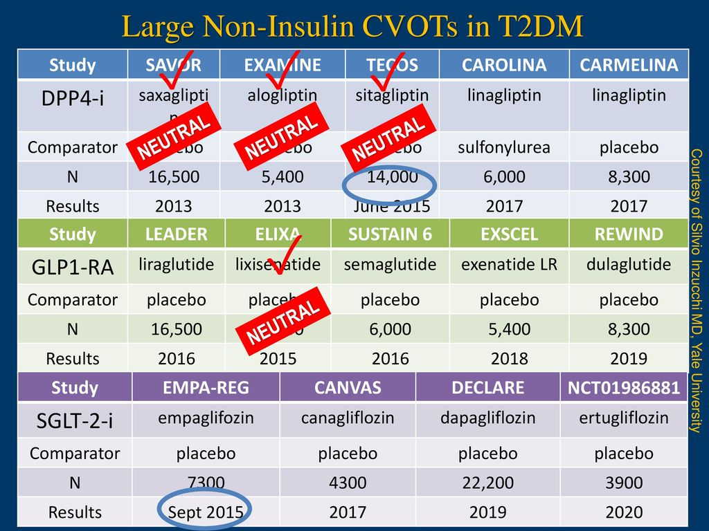

Slide 56
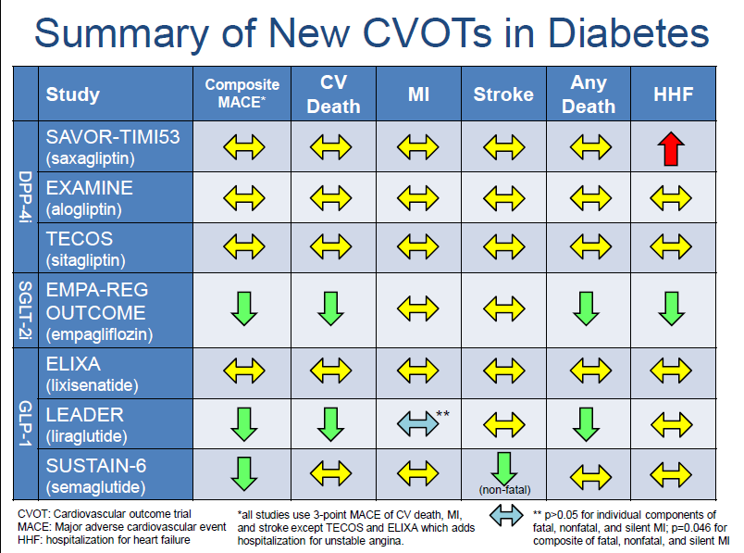

Slide 57
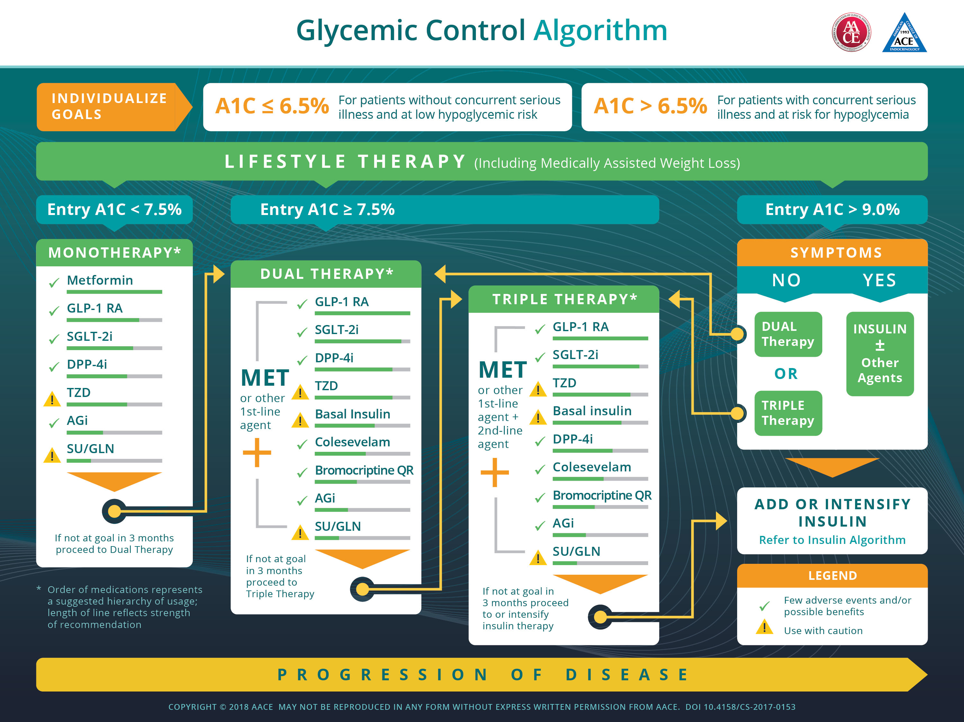

Slide 58
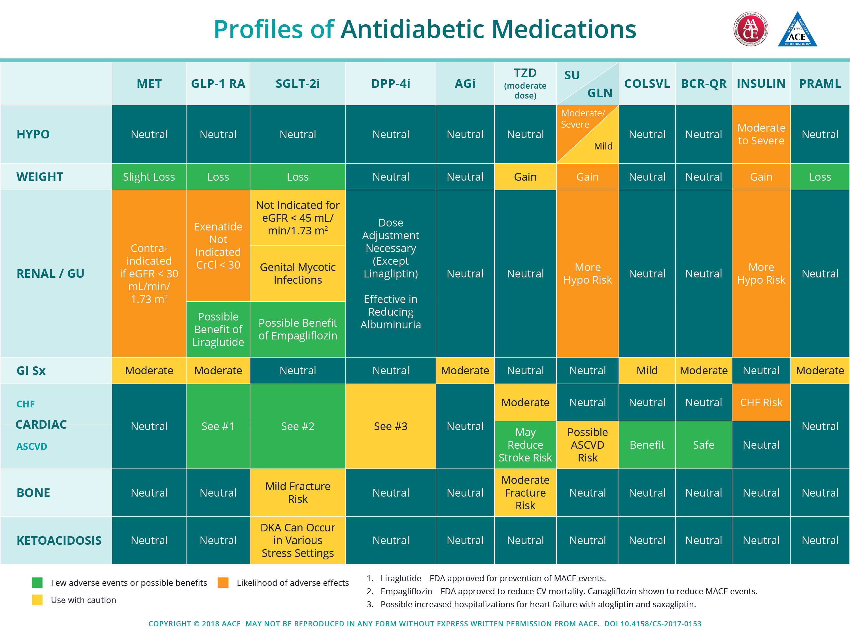

Slide 59



Northwestern Medicine North Region Facilities (shout out to Wellness Center, Anthony Simone and Wellness 180 team)

Slide 60
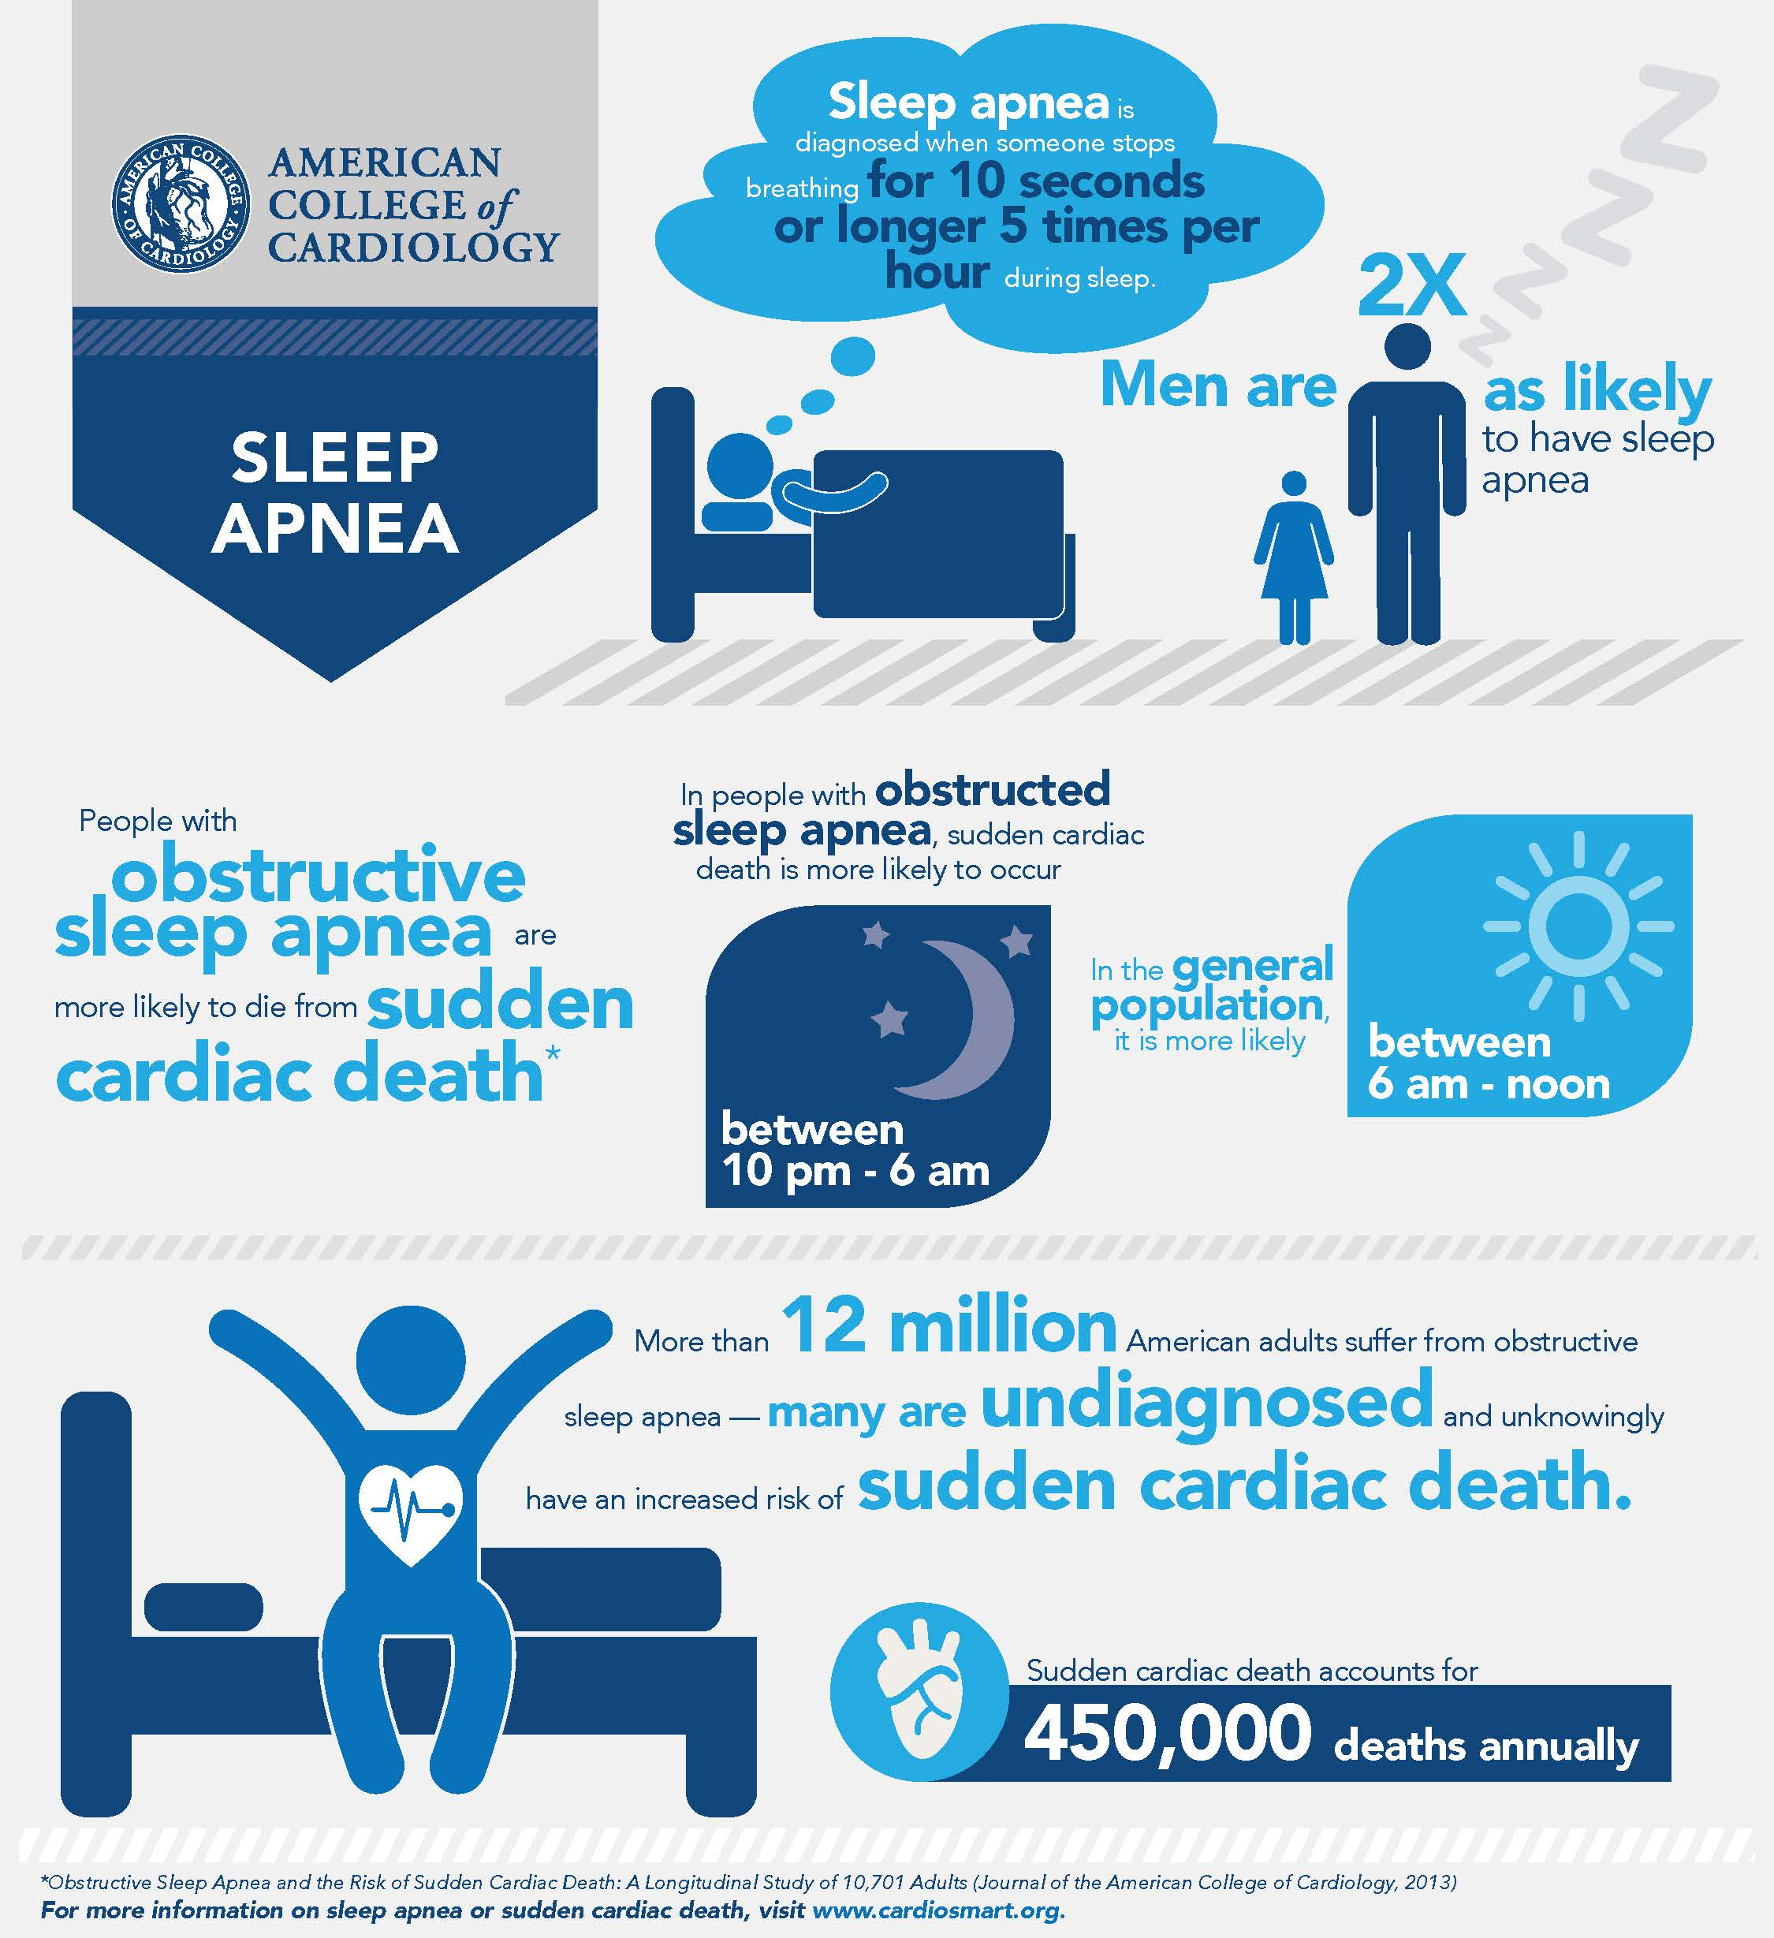

Slide 61
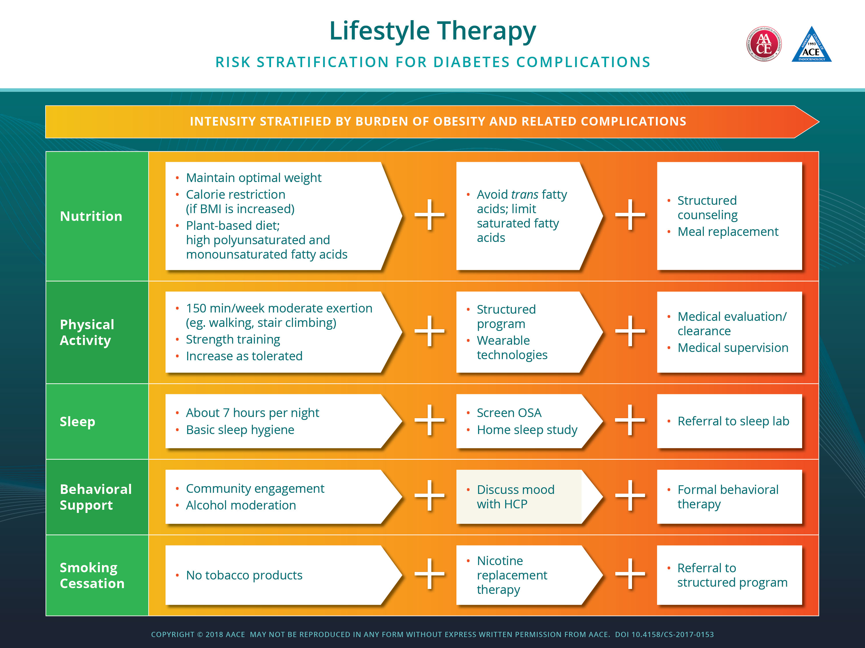

Slide 62


Slide 63
Perioperative Glucose Management
Lake Forest Hospital Fall 2017-
Paradigm shifts
  Obesity is an important, complex, chronic neuroendocrine disease
  How you treat type 2 diabetes matters:
  Pioglitazone lowers risk of MI, stroke, CV death; improves lipids, insulin sensitivity, NAFLD, beta-cell function
  SGL2i: lower risk of CV death (empagliflozin), CKD progression, improve CHF
  GLP1 agents lower stroke, MI and CV death (liragluride) in high risk patients, weight loss, NAFLD, CKD effects

Slide 64
Perioperative Glucose Management
Lake Forest Hospital Fall 2017-
Endocrinology North Region Metabolic Projects
  Outpatient Diabetes Program: intensive management, pumps, sensors, gestational diabetes implemented
  North Region Lipid Clinic: TBD
  Comprehensive Lifestyle Medicine and Weight Program: in development (meal replacement, medical therapy)
  Comprehensive Inpatient Glucose Management service: in development
  Regional approach to diabetes and obesity care at primary care level: in development
  Digital innovation: telehealth; automated inpatient glucose management support (Endotool): In development

Slide 65
Perioperative Glucose Management
Lake Forest Hospital Fall 2017-
Conclusions
  Lifestyle change, weight management and comprehensive risk factor care: NB, easier said than done!!
  Can consider SGL2i, GLP1 analogs and TZD (pioglitazone) cardiovascular medications!!
  Cardiology, endocrinology, fitness Centers, nutrition, cardiac rehab co-location a valuable programmatic opportunity

